Slide 1

How to Update

Slide 2
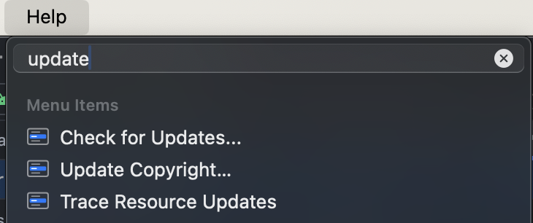
How to update?
First, open up Android Studio!
Then at the top,
Rightmost tab…
Click ‘help’
Search ‘update’
Click ‘check for updates’

Slide 3
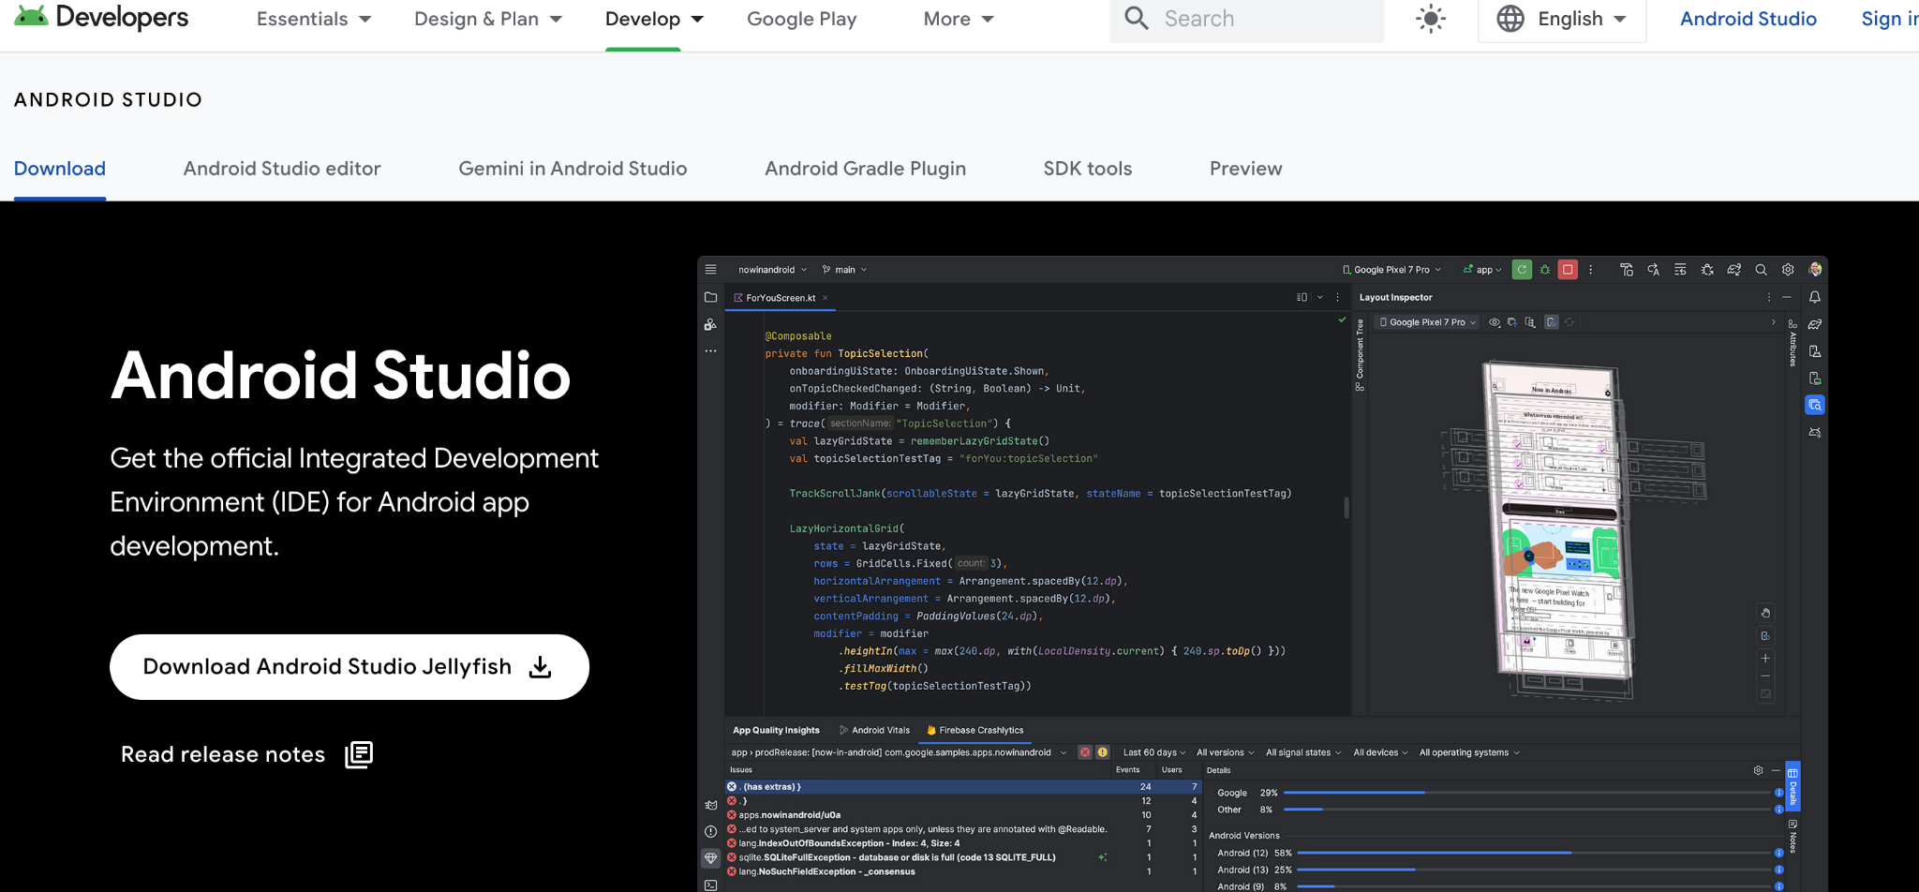
How to update?
When installing, make sure you replace the old Android Studio with the new one.
Download

Slide 4
MAC

Slide 5
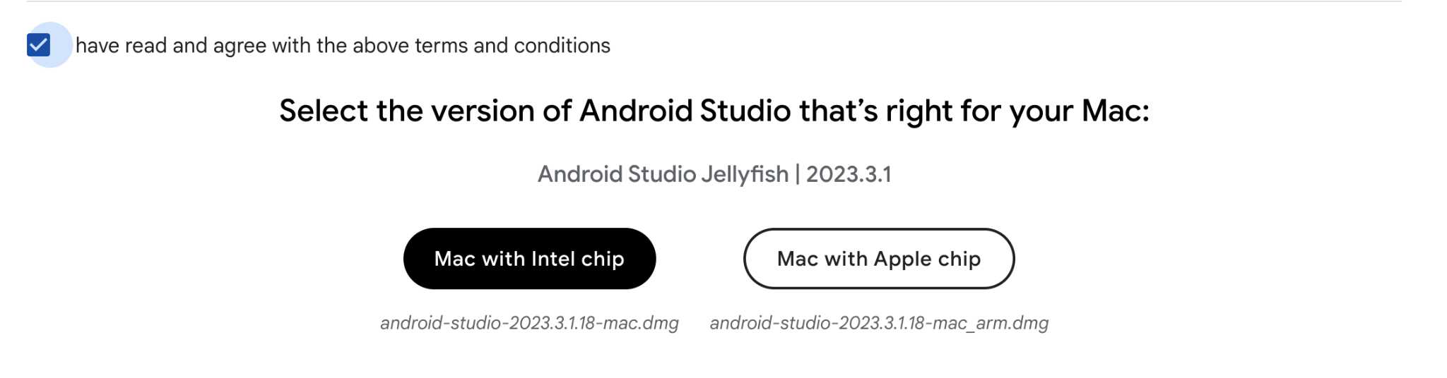
MAC - Chip
Do i have INTEL or APPLE CHIP?

Slide 6
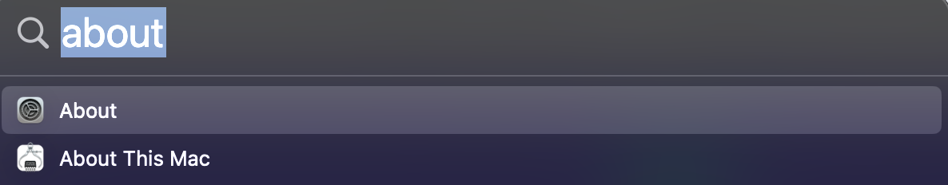
MAC
Command + Space
Brings up the menu, type in ‘about’

Slide 7
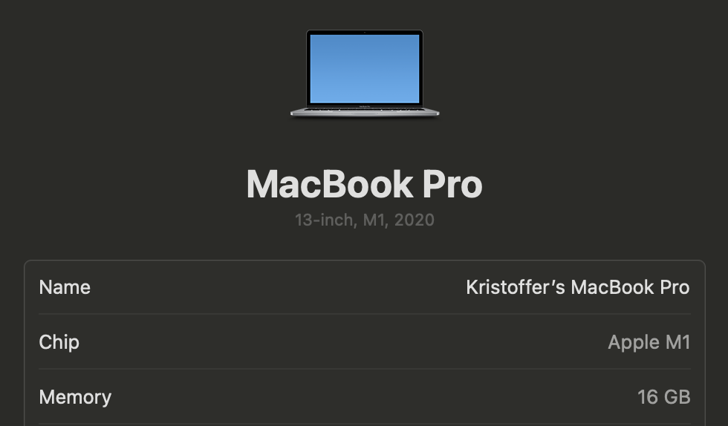
MAC
This confirms i have an APPLE-chip

Slide 8
What changed?

Slide 9
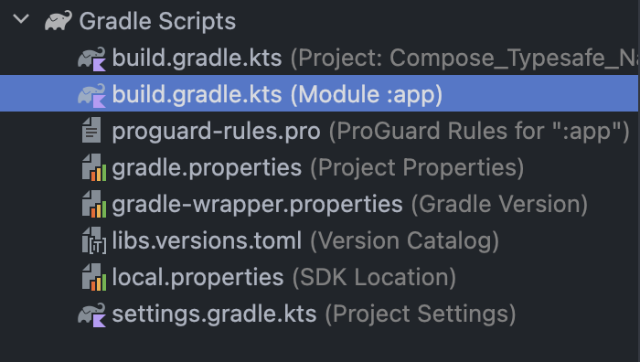
Changes?
If you come from previous versions, you’ll notice how the dependencies have changed in build.gradle.
Let’s check it out!

Slide 10
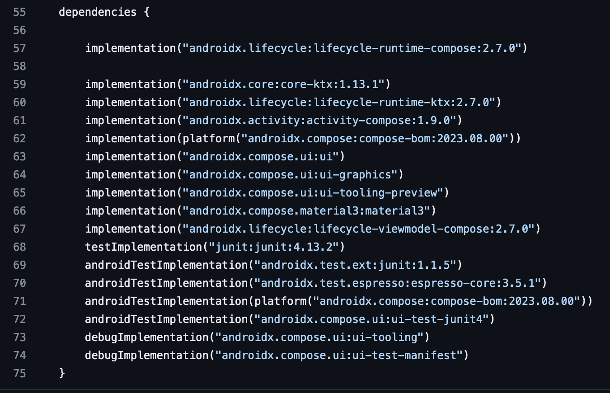
BEFORE

Slide 11
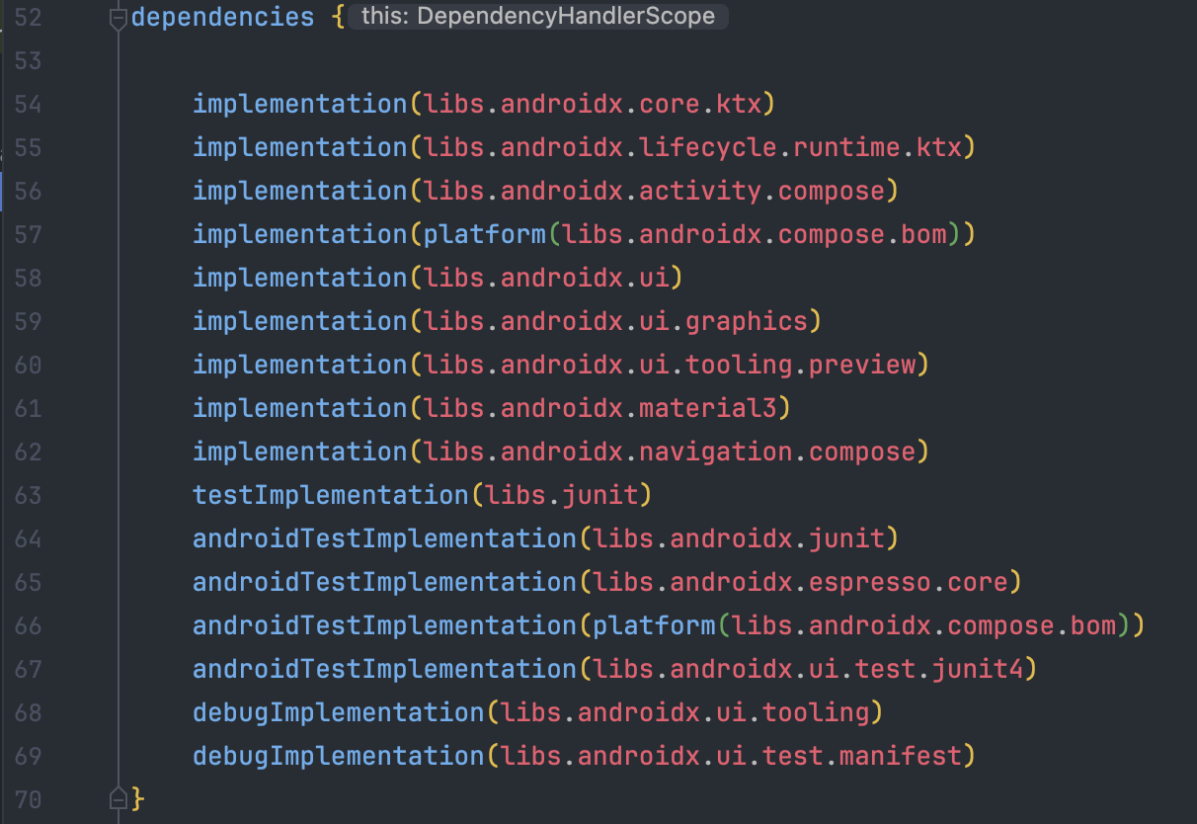
AFTER

Slide 12
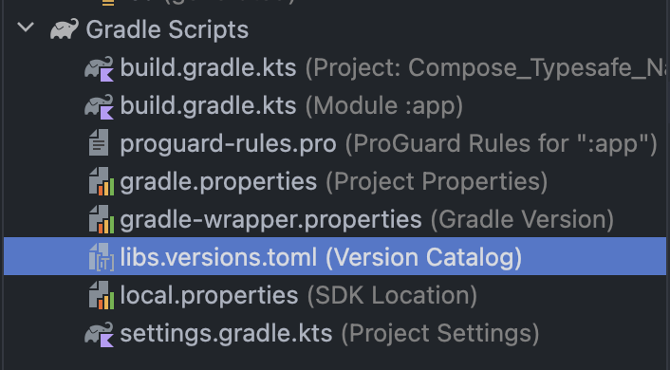
Where Are they now?

Slide 13
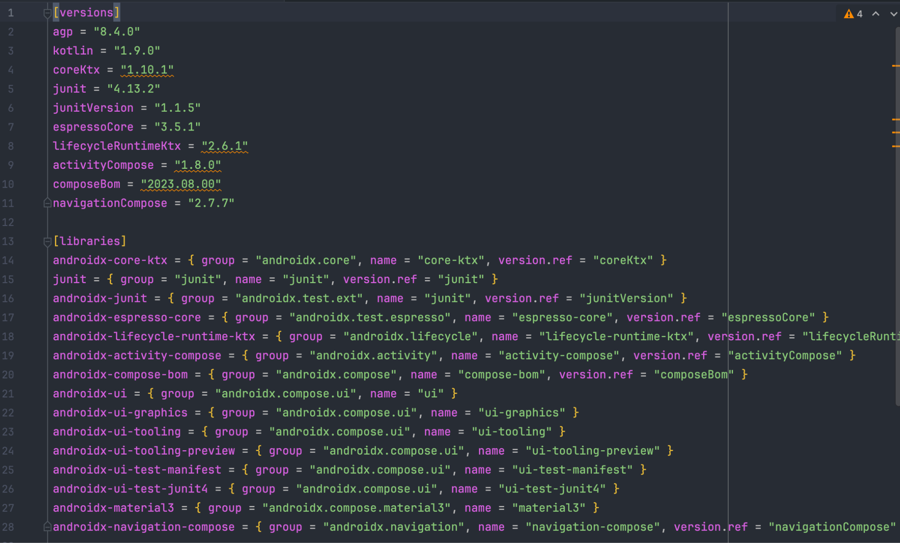
Where Are they now?
Om du behöver ändra på ett ‘dependency’ version, gör detta här!

Slide 14
THANKS!
Do you have any questions?
kristoffer.johansson@sti.se
sti.learning.nu/
You can also contact me VIA Teams (quicker response) Du kan också kontakta mig VIA Teams (Snabbare svar)

